Slide 1


Beginner’s Python – Session Eight
The AZ Code Club Team
Blank Template
Filled Template

Slide 2


Session Content
Reading from a text file
Writing to a text file
Raising errors
Built-in packages/modules

Slide 3
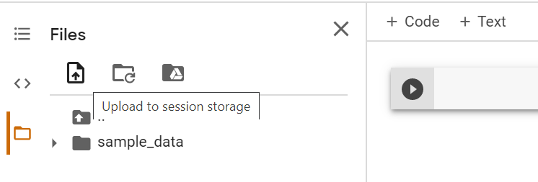
Reading From a Text File
So far, we have seen two fairly limited forms of input to our code
Using the input() function to directly ask for user input
Using an API call
A more powerful technique is to read from text files
You can upload a file to Google Colab to be read by Python from the sidebar

Slide 4
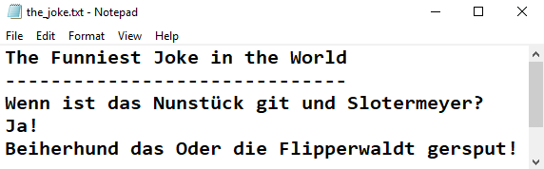

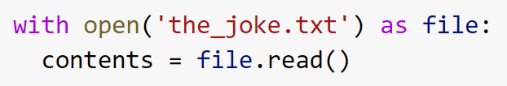
Reading From a Text File
We can read the following text file using the syntax below
Resources
You can replace file with any temporary variable name. A common choice is simply f
Icon made by Pixel perfect from flaticon

Slide 5
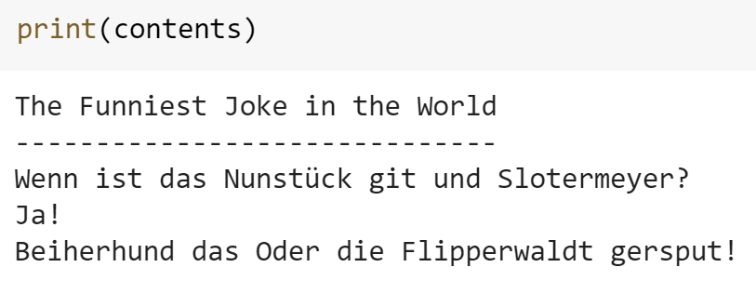
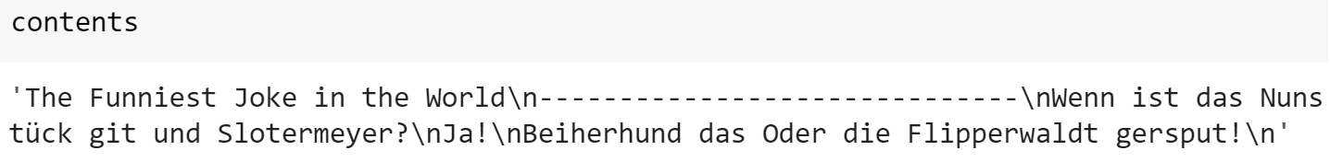
Aside: White lies upon white lies
You may recall that we said you don’t have to use print if you only want to print one output of a cell
There is actually more subtly to this for certain types of objects
Whereas as typing a variable name will print it exactly, the print function will do a bit of tidying first
The most important change is that it evaluates special text characters

Slide 6
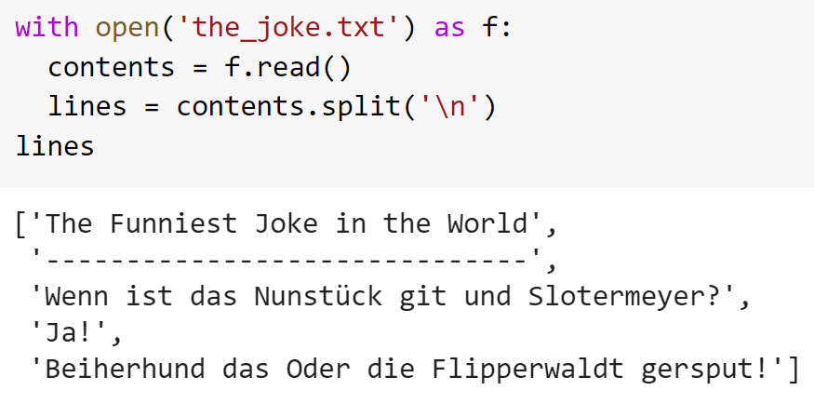
Reading From a Text File
We may want to read a text file into a list with one element per line
There are a few ways to do this. Arguably the easiest is to read the file as one and the split at each newline character

Slide 7
Reading From a Text File Puzzles
Download the text file passcode.txt from the resources of folder of this session’s material on GitHub and upload it to Colab
Import the file and split this into a list of lines
Loop through this list using enumeration to print out every tenth line (i.e. lines whose index is divisible by ten)

Slide 8
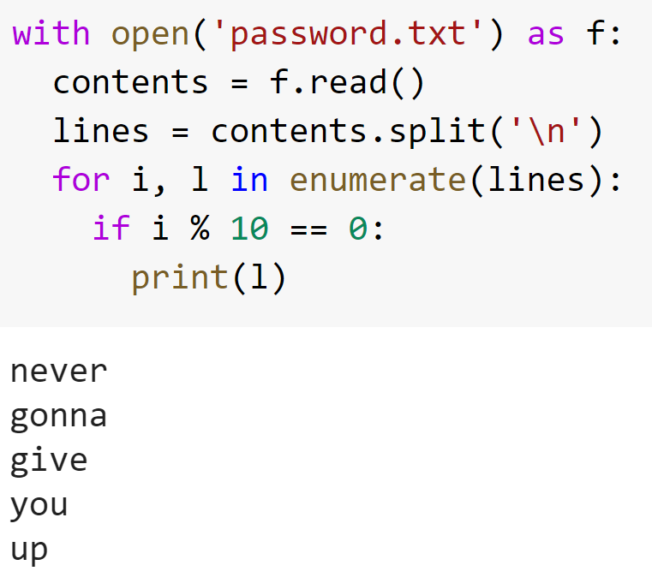
Reading From a Text File Puzzles Solutions

Slide 9
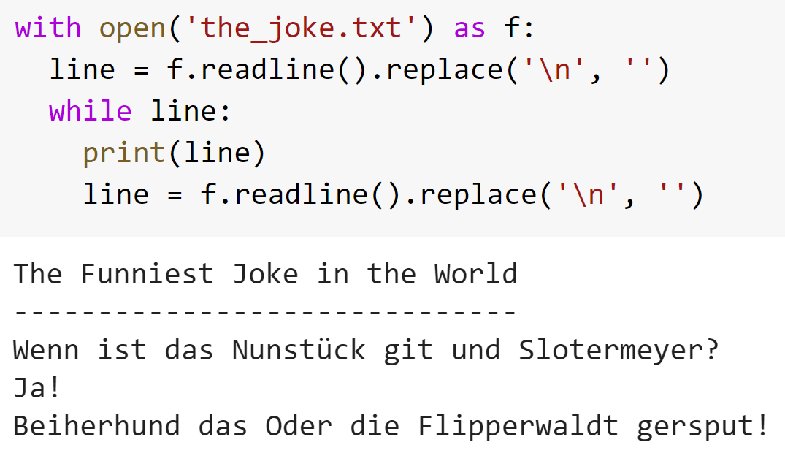
Reading Text Files Sequentially
We may want to read a text file into a list with one element per line
For example, when a text file is large, reading the who thing may consume too much memory
We can do this with .readline() and .replace()

Slide 10
Reading Text Files Sequentially Puzzles
Repeat the previous exercise but by reading the file sequentially (hint: you will need to create a variable to count what line you’re on)
Read only the title and first line of ‘The Joke’

Slide 11
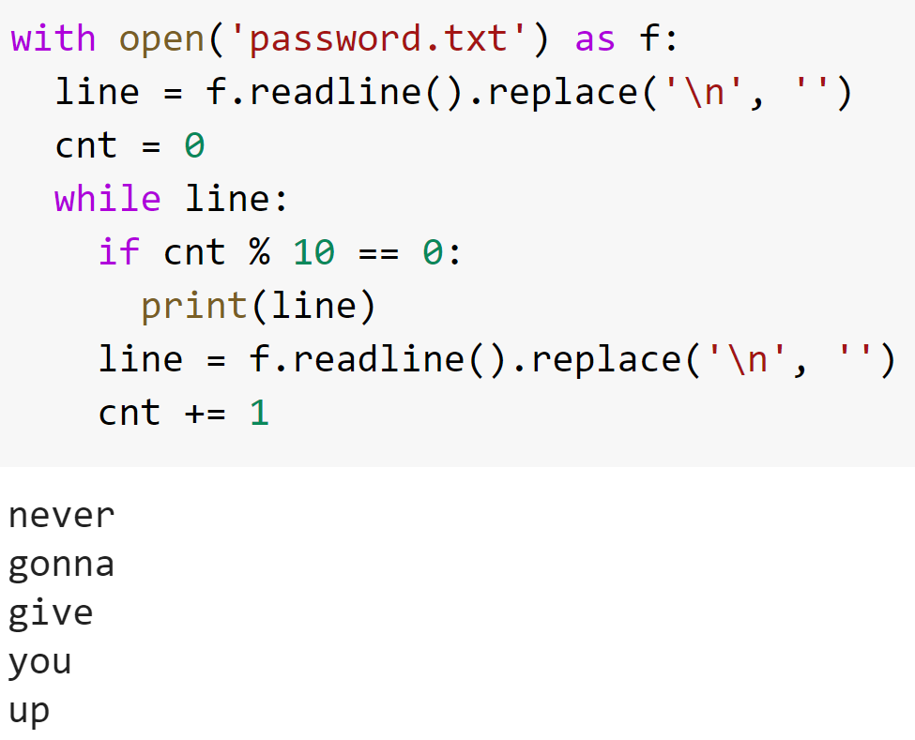
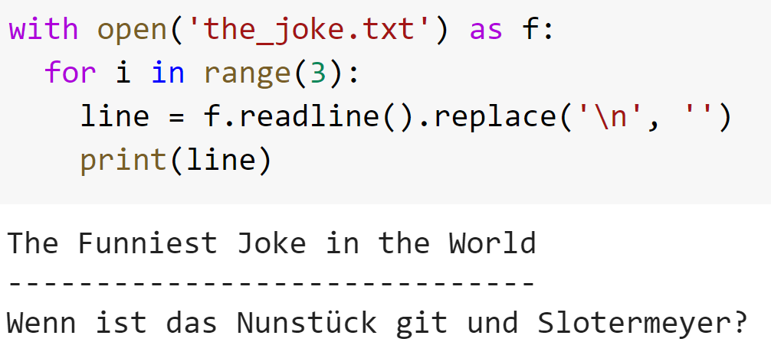
Reading Text Files Sequentially Puzzles Solutions

Slide 12
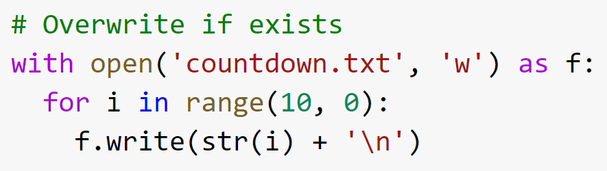
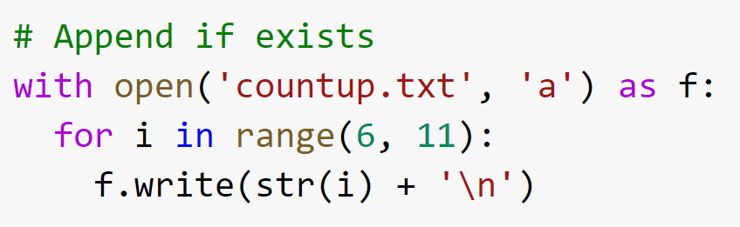
Writing to Text Files
We can write to a file using the .write() method
To do this we must add new lines using ‘\n’
When we open the file we must specify the we are using write mode or append mode

Slide 13
Writing to Text Files Puzzles
Ask the user for their name and write it to a text file called ‘user_details’ in the form ‘Name: Tim’
Ask the user for their favourite food and append this to the text file on a new line in the form ‘Favourite Food: Pizza’
Bonus: What happens when you append to a file that doesn’t exist?

Slide 14
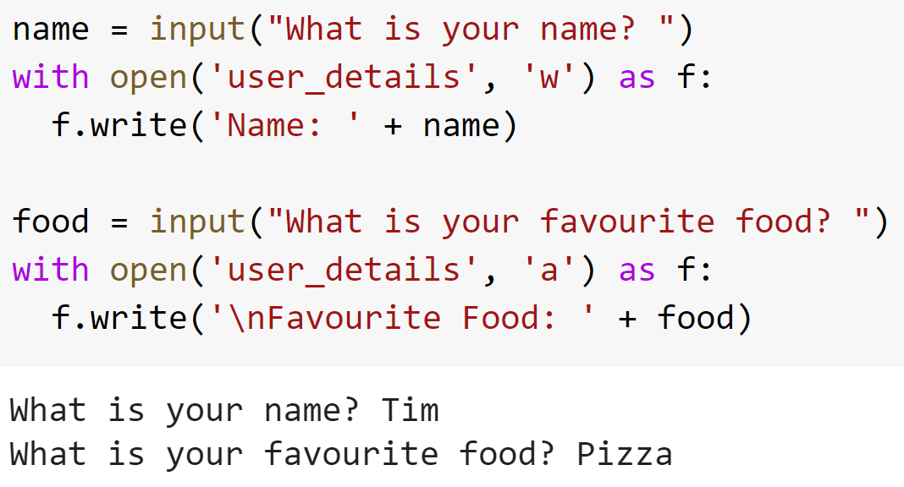
Writing to Text Files Puzzles Solutions

Slide 15
Raising Errors
As of yet, the only way we’ve had to inform a user of an error is to print a message and then use control flow to change the code we run
We can do better than this by raising an error
Python has many types of errors built-in and you can define your own too
The most common are:
TypeError: When an object is of an incorrect type
ValueError: When an object has an invalid value
OSError: When a system operation is invalid

Slide 16
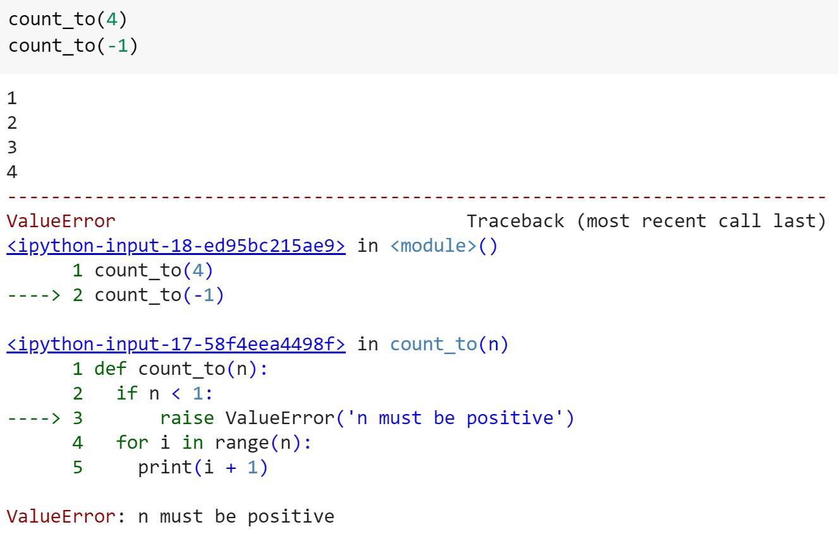
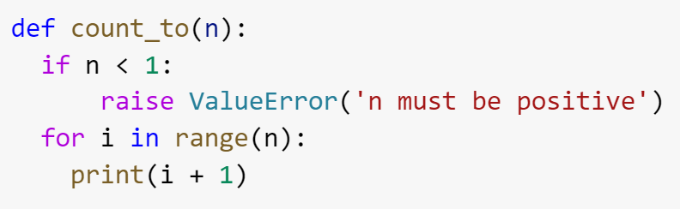
Raising Errors
To raise an error, we use the raise keyword followed by the type of error, with a message passed as the only argument
Raising an error will stop code execution for the entire block

Slide 17
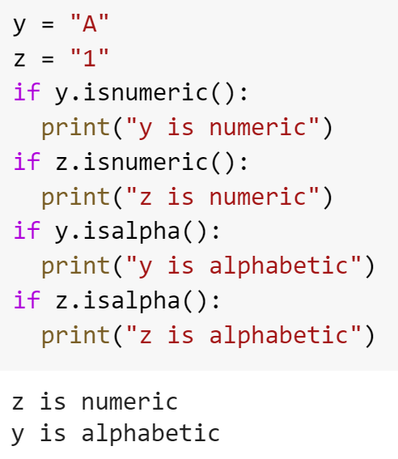
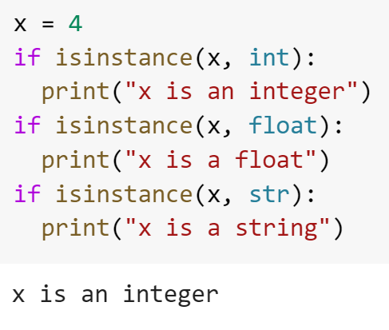
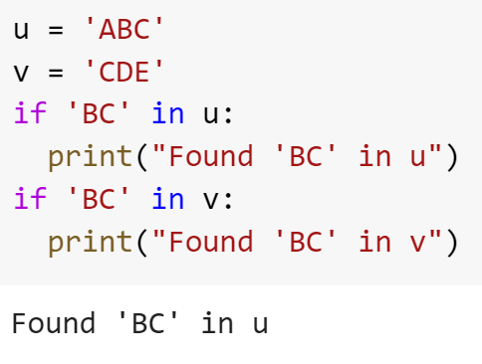
Aside: Validation Helpers
There are many useful functions for validating input. We see a few examples below

Slide 18
Raising Errors Puzzles
Create a function called print_sentence which accepts a string as its only parameter. First check that the input is a string, and if not, raise a TypeError with an appropriate message
Next, check that the string contains a space character. If not, raise a ValueError
Finally, if the above two conditions are met, print the string
Create a function called forgiving_double which accepts a single argument. If the number is a numeric string, convert it to an integer and double it. If it is a non-numeric string, raise a ValueError with a suitable error message
After possible conversion, double the number and return this new value.

Slide 19
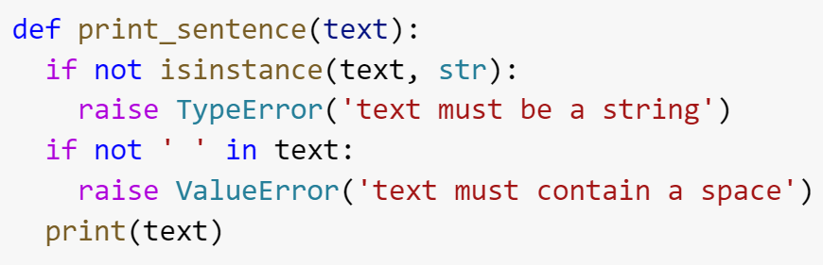
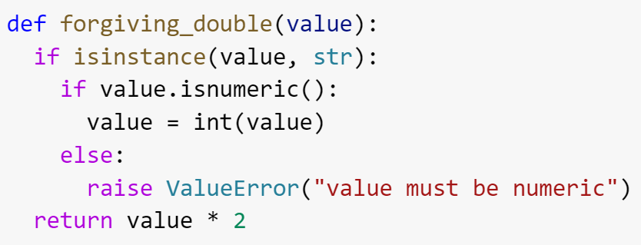
Raising Errors Solutions

Slide 20
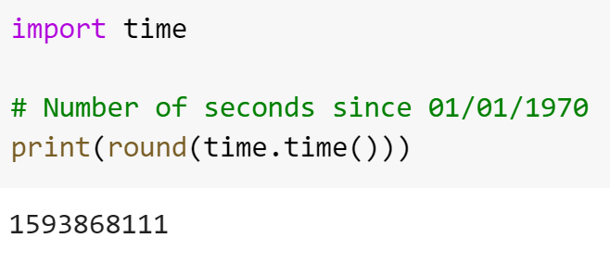
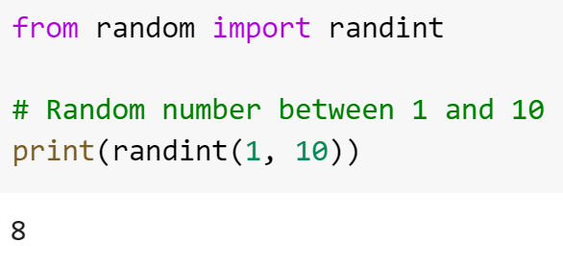
Built-in Modules
So far, we have only used the functionality of Python that is loaded by default
We can get access to more powerful tools by importing built-in modules
A module can generally be thought of as a collection of functions and objects. Examples include random, time, and os
There are a few ways we can import a module’s contents

Slide 21
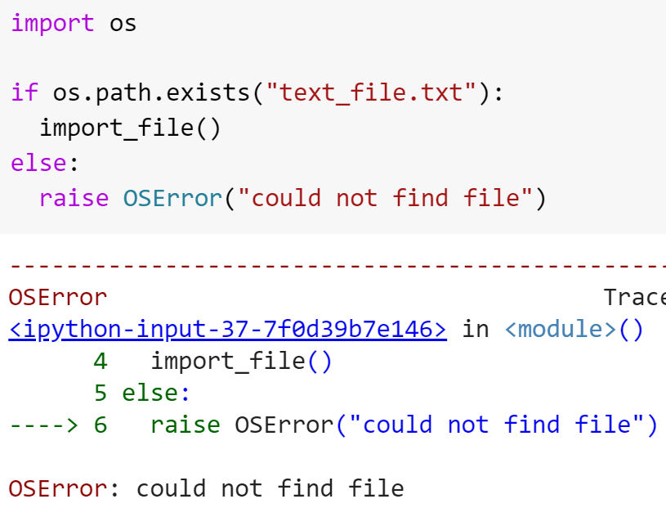
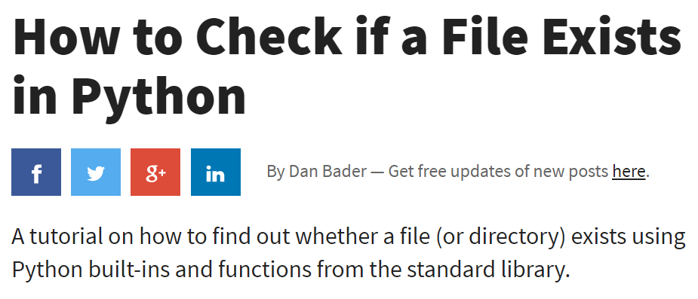
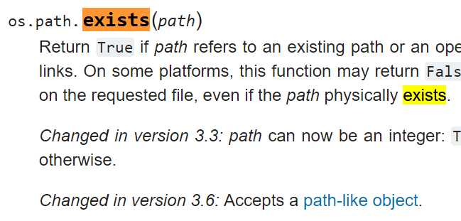
Built-in Modules
There are many built-in modules with a wide array of features
You are not expected to remember these
Instead, use the documentation, or search the web for how to achieve your goal
Example: how to check if a file exists

Slide 22
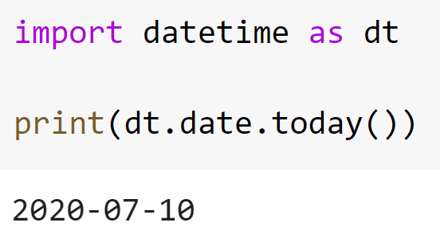
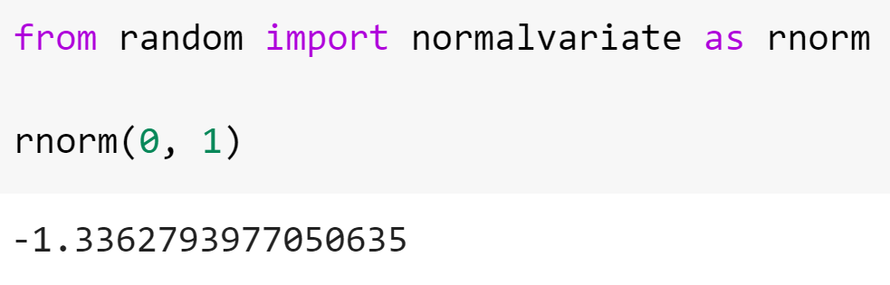
Aside: Aliases
You may want to import long module/function names using a shorter name
You can do this using the as keyword

Slide 23
Built-in Modules Puzzles
Import the random module using the alias rand
Use this to create a guessing game in which a user has 3 guesses at a number randomly chosen between 1 and 20. You should let the user know if they are higher or lower each time.
Hints: use a while loop with variables tries and correct to keep track of how many guesses the user has taken and whether they have guessed correctly respectively
Import the combinations product from the package itertools
By searching for documentation on this function, use this to print out all possible pairings of the names Ann, Bob, and Cat

Slide 24
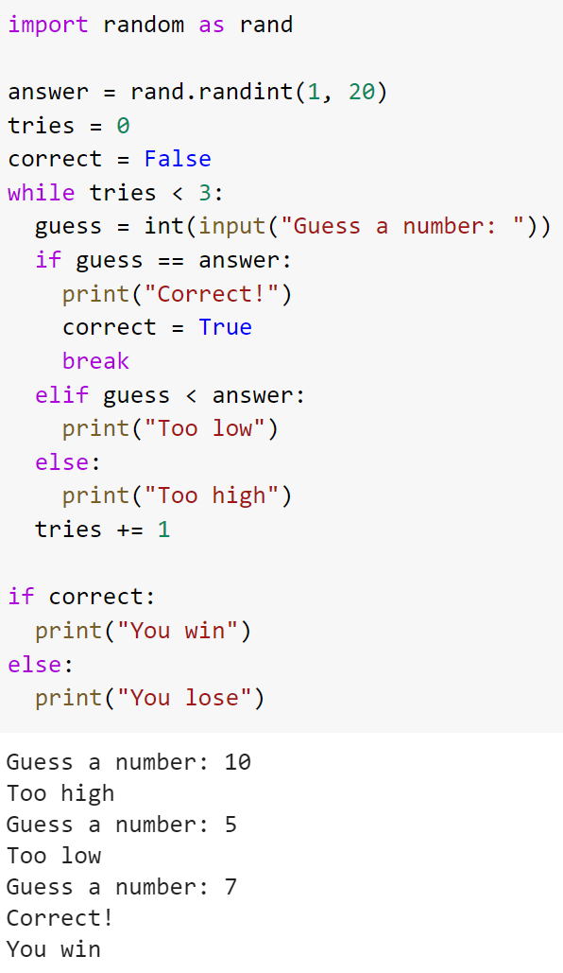
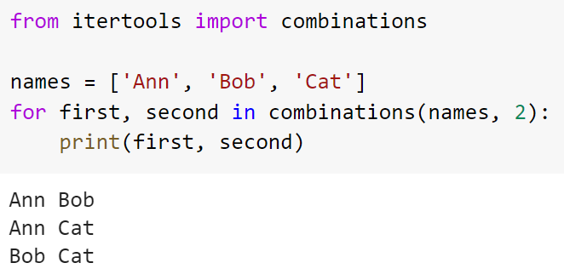
Built-in Modules Puzzles Solutions

Slide 25
Closing Notes
You now hopefully have a good understanding of the basics of Python
This is likely not enough to solve any large problems, but is a necessary foundation for learning more
Next steps are determined by your goals
Simulation and statistics: numpy and scipy
Computational chemistry: RDKit, matplotlib
Data analysis: pandas, matplotlib
Machine learning: Data analysis packages + sklearn, tensorflow
To learn more about a variety of these, look into the Data Science for Python course taught by the Data Science Academy at AZ
Or, now that you have overcome the first hurdle, you might feel ready to learn more by yourself

